Slide 1





MARKETPLACE FOR NORTHWEST
Dr. Chandra mouli KOTTETI – Client/mentor
Sajida mohammad – Backend developer
USHA PATI – Front End Developer
Hari Kiran aluri – Team lead/Front-end developer
KIRAN KUMAR GUNDAPUNENI– Backend developer
APP URL: http://52.22.24.58:8080

Slide 2

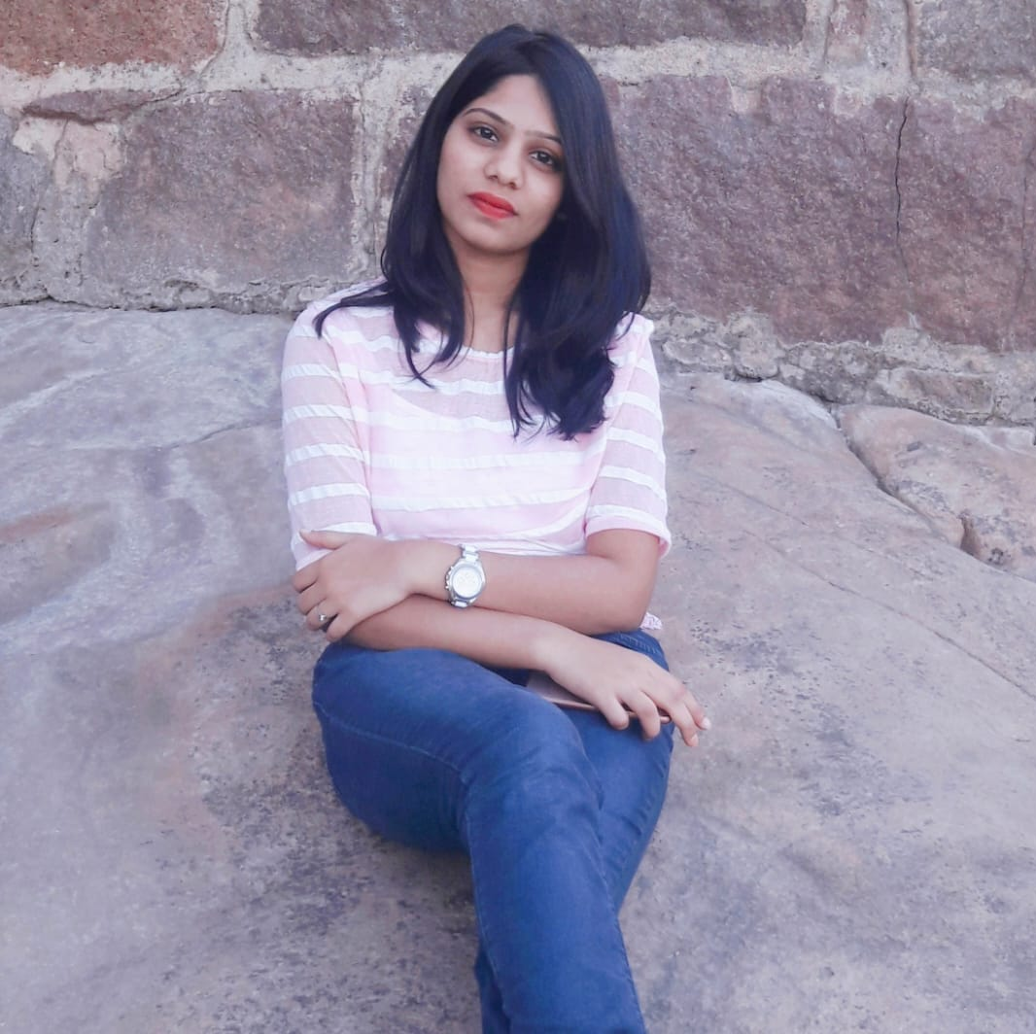
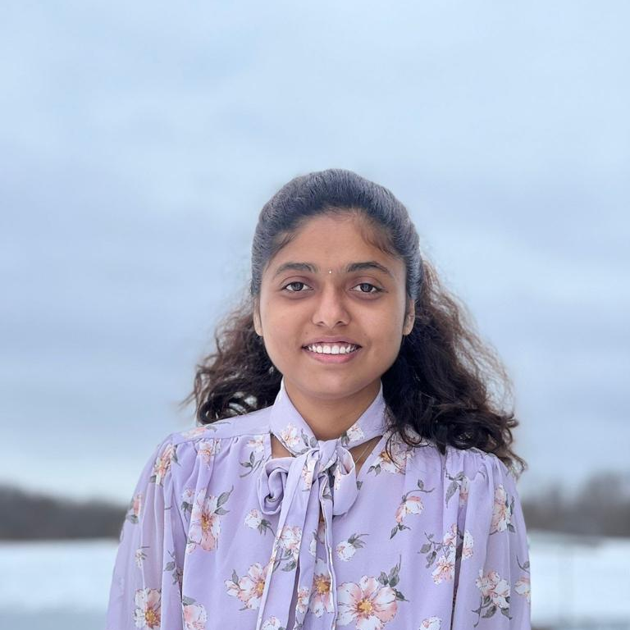
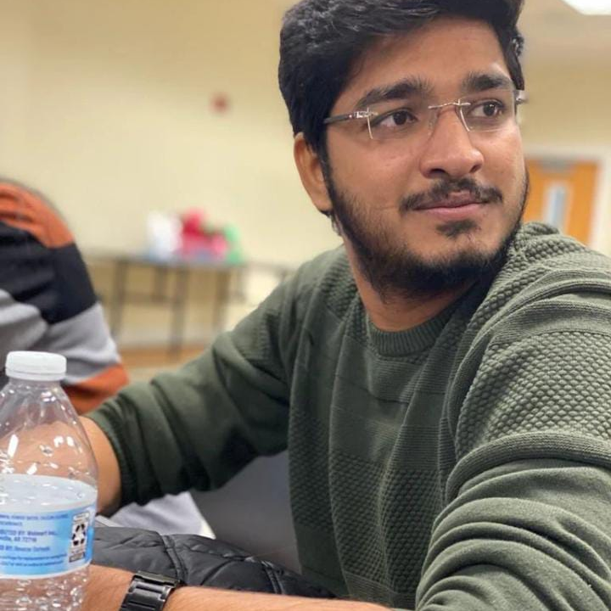
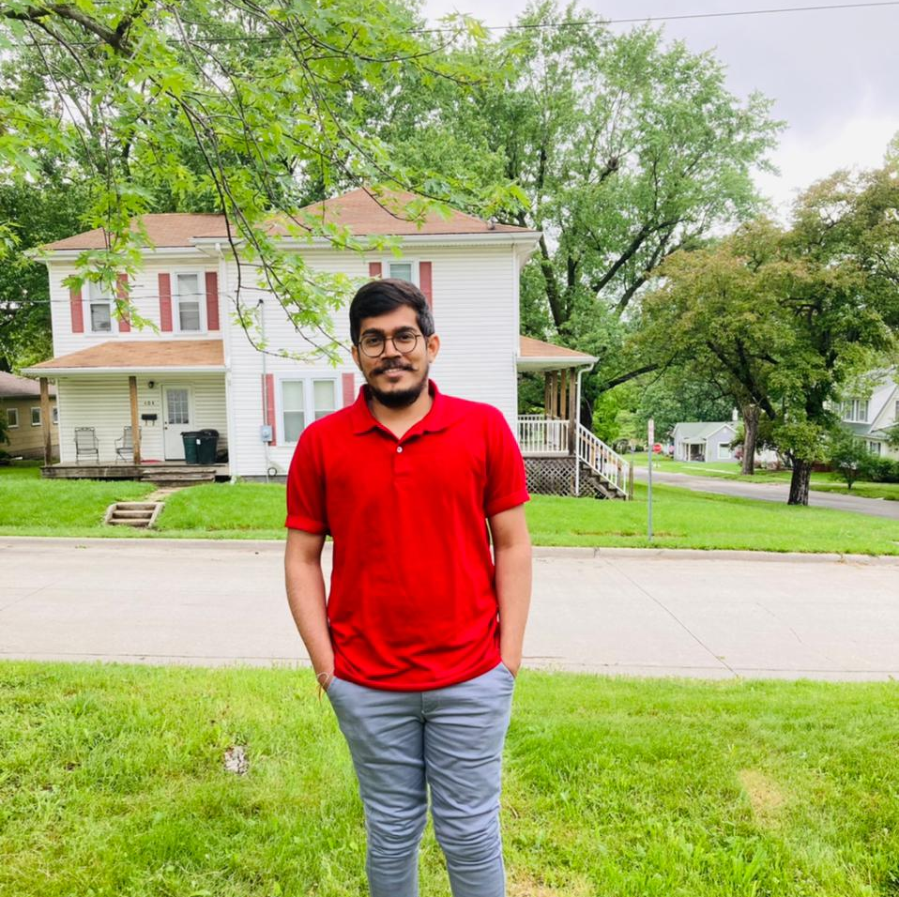
Team members
DR.CHANDRA MOULI
KOTTETI
SAJIDA MOHAMMAD
USHA PATI
HARI KIRAN ALURI
KIRAN KUMAR GUNDAPUNENI

Slide 3
Agenda
Introduction
Protecting routes
Web Storage API
S3 Bucket
Lessons Learnt
Design Challenges
Summary
Sajida Mohammad

Slide 4
Routes Protection
Navigation Guard is used to protect web pages from unauthorized access
Function that can either allow or block the Navigation
beforeEach() method of Vue Router can be used for implementation
Sajida Mohammad

Slide 5
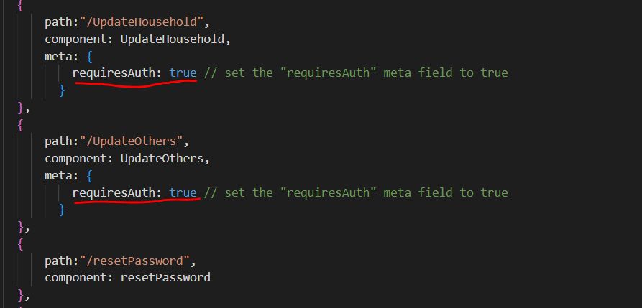
Routes Protection
Set the Meta data in the routes which require authentication
Fig 1.1 index.js file
Sajida Mohammad

Slide 6
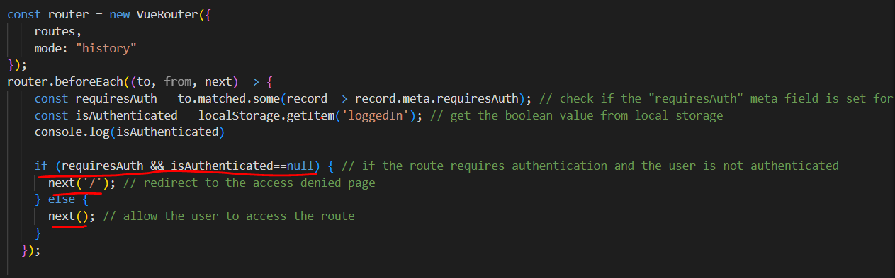
Routes Protection
Call beforeEach() method of router
Sajida Mohammad
Fig 1.2 index.js file

Slide 7
Web Storage API
The Web Storage API is a set of web standards that allows web applications to store data on the client-side, specifically within the user's web browser.
The two main types of storage provided by the Web Storage API
Local Storage
Session Storage
Usha Pati

Slide 8
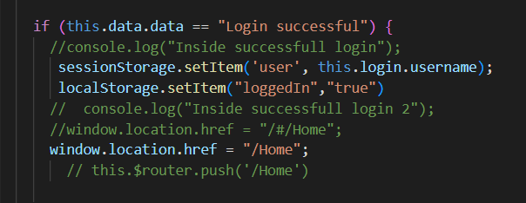
Web Storage API
Fig 2 Web Storage Code
Usha Pati

Slide 9
Advantages of Web Storage
Client-side storage
Easy to use
Cross-browser compatibility
Improved performance
Scalability
Usha Pati

Slide 10
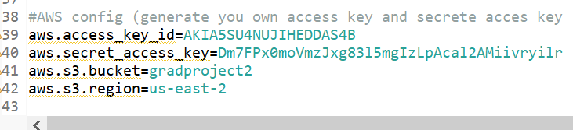
Application Properties
Fig 3.1 shows properties for S3 Buckets
Hari Kiran Aluri

Slide 11
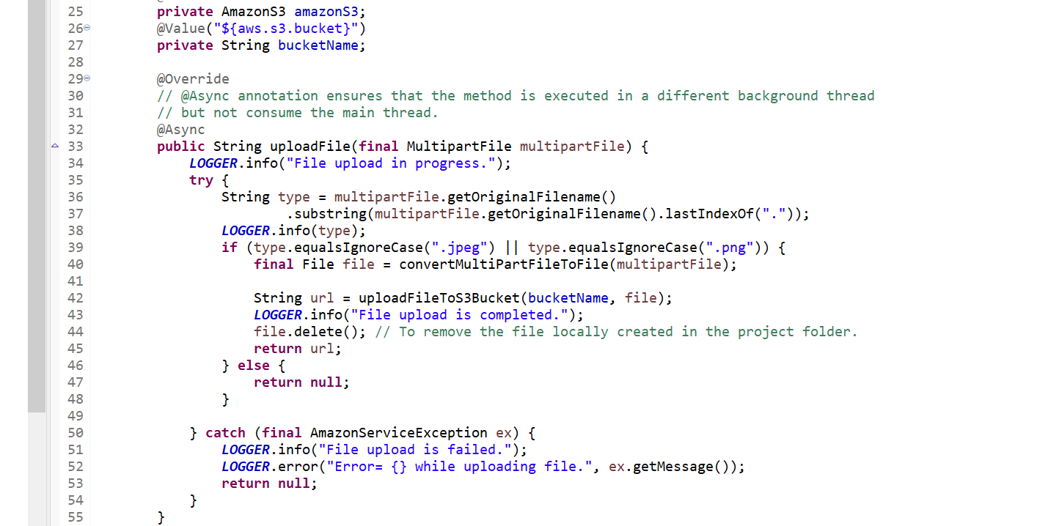
Upload File method in java
Fig 3.2 shows the method to Upload Files
Hari Kiran Aluri

Slide 12
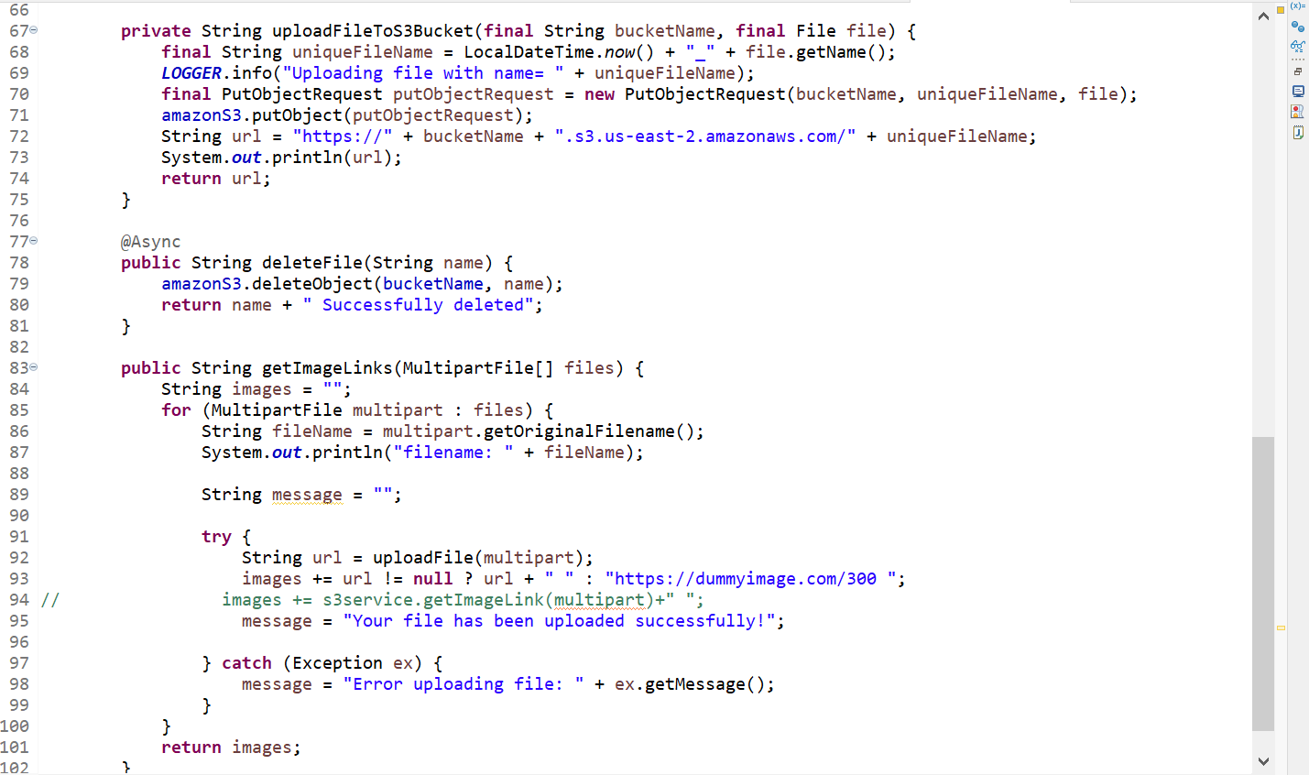
Method in java
Fig 3.3 shows the method
Hari Kiran Aluri

Slide 13
Lessons learnt
Faced challenges while implementing images to the UI via the database
Overcome it by using the S3 Bucket from AWS
Implemented EC2 instance and deployed the code by integrating it with GitHub
Initially planned to deploy the code with a jar file for the backend and spec file for frontend
Kiran Gundapuneni

Slide 14
Design Challenges
Should have analyzed the technical or low-level design or proof of concept before jumping into development for handling images like upload from desktop.
Free tier limitations were also observed when handling free SQL databases and switching to AWS RDS Service resolved the issue
Cross-browser testing should have been identified early. But later it was implemented.
Kiran Gundapuneni

Slide 15
Summary
In short, a website for the marketplace for Northwest Missouri State University is developed and deployed on the cloud
Functionality is developed as promised and testing is done for all the use case scenarios
It’s an application with Java language with Spring Framework and used hibernate queries for the run time and Vue js for the front end and MySQL for database
Kiran Gundapuneni

Slide 16
References
GitHub link: https://github.com/harichowdary-aluri/gdp_1-project
EC2 App URL: http://52.22.24.58:8080
Any Questions: https://www.slidegeeks.com/business/product/any-questions-ppt-powerpoint-presentation-inspiration-example-file
Kiran Gundapuneni

Slide 17


THANK YOU

Slide 18
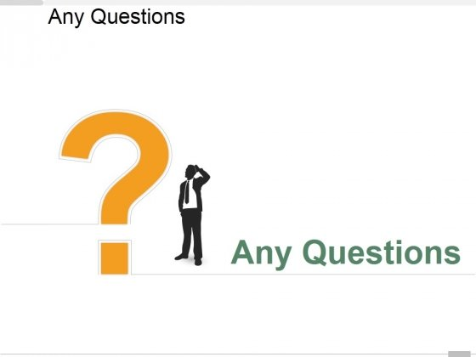

Slide 19
Team members
DR.CHANDRA MOULI
KOTTETI
SAJIDA MOHAMMAD
USHA PATI
HARI KIRAN ALURI
KIRAN KUMAR GUNDAPUNENI

Slide 20
MARKETPLACE FOR NORTHWEST
Dr. Chandra mouli KOTTETI – Client/mentor
Sajida mohammad – Backend developer
USHA PATI – Front End Developer
Hari Kiran aluri – Team lead/Front-end developer
KIRAN KUMAR GUNDAPUNENI– Backend developer
APP : http://52.22.24.58:8080/

